Slide 1

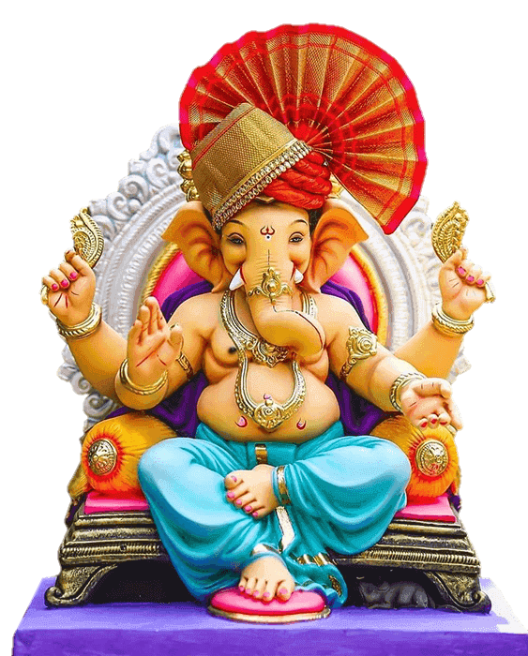



ukf‘kd ‘kgj iksyhl vk;qDrky;

Slide 2
izLrkouk
Jhx.ks’kksRlo o bZn , feykn cankscLr r;kjh o vk<kok
Ukkf‘kd iksyhl vk;qDrky; gn~nhr Jh x.ks’kksRlok fufeRr Jh x.ks’k vkxeu fejo.kqdk fu?kr vlrkr- lkoZtfud eaMGs tkxsoj x.ks’keqrhZph LFkkiuk djrkr- fofo/k fo”k;kaoj ns[kkos lknj dsys tkrkr- R;kvuq”kaxkus lu 2024 x.ks’kksRlo fn- 07@09@2024 rs 17@09@2024 njE;ku lktjk gks.kkj vkgs- R;kvuq”kaxkus cankscLrkps fu;kstu dj.;kr vkys vkgs rlsp x.ks’k eaMG] brj iz’kklu]iksyhl iz’kklu ;kaP;k leUoa; cSBdk ?ks.;kr vkY;k vkgsr- cankscLrkdfjrk vfrfjDr euq”;cGkph ekx.kh dj.;kr vkysyh vkgs-
‘kgjkr egRokP;k fBdk.kh v o c rlsp fQDl ikWabZV yko.;kr ;s.kkj vkgs- rlsp egRokps pkSdkr]jLR;koj osGksosGh ukdkcanh yko.;kps fu;kstu vkgs-
x.ks’kksRlo o bZn &,&feykn ps vuq”kaxkus brj iz’kkldh; foHkkx ;kauh djko;kP;k dk;Zokghdfjrk vko’;d rks i=O;ogkj dj.;kr vkysyk vkgs-
x.ks’k folZtu fejo.kqd ekxkZph ifjeaMG fugk; ikg.kh dj.;kr vkyh vkgs- ikg.kh njE;ku vkysY;k vMp.kh ckcr lacf/kr foHkkxkl dGfo.;kr vkys vkgs-
ukf’kd iksyhl vk;qDrky; gn~nhr 03 izeq[k folZtu fejo.kqdkaps vk;kstu dj.;kr ;srs-
fn-16@09@2024 jksth lkt&;k gks.kk&;k bZn &,&feykn vuq”kaxkus lacf/kr ekSykuk o VªLVh ;kaph cSBd ?ks.;kr vkyh vkgs-

Slide 3
lkoZtfud Jh x.ks’kksRlo lu &2024
x.ks’k prqFkhZ ¼LFkkiuk½ fnukad 07@09@2024
Jh x.ks’k foltZu o bZn&,&feykn fnukad 16@09@2024
lu 2024 x.ks’kksRlo dk;Zdze [kkyhy izek.ks
1½ fn-07@09@2024 ‘kfuokj & Jh x.ks’k prqFkhZ&Jh x.ks’kkph eqrhZph izfr”Bkiuk-
2½ fn-08@09@2024 jfookj & fnM fnolkP;k Jh x.kirh eqrhZps foltZu
3½ fn-10@09@2024 eaxGokj & xkSjh vkxe.k
4½ fn-11@09@2024 cq/kokj & xkSjh iqtu] ikp fnolkP;k Jh x.kirh eqrhZps foltZu
5½ fn-12@09@2024 xq:okj & xkSjh o xkSjhcjkscjP;k Jh x.kirh eqrhZps foltZu
6½ fn-13@09@2024 ‘kqØokj & lkr fnolkaps Jh x.kirh eqrhZps foltZu
7½ fn-17@09@2024 eaxGokj & vuar prqnZ’kh 10 fnolkps Jh x.kirh eqrhZps foltZu gks.kkj vkgs-
v’kkizdkjs x.ks’k mRlo laiUu gks.kkj vkgs-
Rklsp fn- 16@09@2024 jksth eqfLye cka/kokapk bZn &,&feykn l.k vkgs-

Slide 4
/ouh{ksid ijokuxh
Jhx.ks’kksRlo dkGkr [kkyhy ‘ksoVps 04 fnol jk=h 12-00 okts ikosrks ok| oktfo.ks] /ouh{ksid ijokuxh
¼egkjk”Vª ‘kklu ;kapsdMhy vkns’kkUo;s½
v½ fn-14@09@2024 ¼x.kirh vkjkl ikg.;klkBh½
c½ fn-15@09@2024 ¼x.kirh vkjkl ikg.;klkBh½
d½ fn-16@09@2024 ¼x.kirh vkjkl ikg.;klkBh½
M½ fn-17@09@2024 ¼Jhx.ks’k foltZu fejo.kwd½

Slide 5
2- lu 2024 e/khy x.ks’k eaMGkapah la[;k
1½ lkoZtfud eksBh eaMGs % 201
2½ lkoZtuhd ygku eaMGs % 562
3½ ekSY;koku eaMGs % 35
4½ ,dq.k eaMGs % 790
5½ [kktxh x.ks’k eaMGs ¼vankts ½ % 1]25]389

Slide 6
3- lu 2022 o 2023 x.ks’kksRlo ijokuxh lkBh vkysys vtkZaph ekfgrh
l.k & 2022 | Lk.k2023 | l.k 2024
790 | 843 | 980 vankts

Slide 7
4- leUo; cSBd
x.ks’kksRlo vuq”kaxkus fn- 30@09@2024 jksth 13%0 ok- fu;kstu Hkou ;kfBdk.kh vkn’kZ x.ks’k eaMG &2023 ikfjrks”khd forj.k lekjaHkkps vkf.k x.ks’kksRlo 2024 lanHkkZus x.ks’k eaMGkaP;k inkf/kdkjh ;kaph cSBd ek- ikydea=h ;kaP;k v/;{krs[kkyh vk;ksftr dj.;kr vkyh-
x.ks’kksRlo vuq”kaxkus izR;sd foHkkxkus djko;kP;k dk;Zokgh ckcr lacf/kr jktdh; inkf/kdkjh] ‘kkldh; foHkkxkps vf/kdkjh] x.ks’k eaMGkps inkf/kdkjh o v/;{k o ‘kkarrk lferhps lnL; rlsp iksyhl vf/kdkjh ;kaph leUo; cSBd fn- 03@09@2023 jksth 16%30 ?ks.;kr vkyh vkgs-

Slide 8
5- x.ks’kksRlokP;k vuq”kaxkus ?ks.;kr vkysY;k cSBdk
iks-LVs | ‘kkarrk dfeVh | iksyhl fe= | eksgYyk | brj | ,dq.k
vkMxko | 01 | 00 | 02 | 05 | 08
Egl:G | 01 | 01 | 01 | 02 | 05
iapoVh | _ | 02 | _ | 04 | 06
Hknzdkyh | 01 | 0 | 0 | 02 | 03
eqacbZukdk | 0 | 0 | 01 | 05 | 06
ljdkjokMk | 01 | 0 | 01 | 02 | 04
xaxkiqj | 05 | 0 | 05 | 25 | 35
lkriqj | 02 | 0 | 01 | 03 | 06
vacM | 02 | 02 | 05 | 02 | 11
bafnjkuxj | 01 | 03 | 04 | 01 | 09
miuxj | 02 | 02 | 01 | 02 | 07
ukf’kdjksM | 02 | 02 | 03 | 02 | 09
ns- dWEi | 01 | 0 | 0 | 01 | 02
paqapkGs iks-pkSdh | 01 | 0 | 02 | 02 | 05
,dq.k | 20 | 12 | 26 | 58 | 116
ojhy cSBdk O;frfjDr x.ks’kksRlokP;k vuq”kaxkus vf/kd cSBdkaps fu;kstu dj.;kr ;s.kkj vkgs-

Slide 9
eq[; foltZu fejo.kqdk ekxZ
1½ Hknzdkyh] ljdkjokMk o iapoVh iks-LVs- gn~nhr%&
ukf’kd ‘kgjkrhy eq[; x.kirh foltZu fejo.kqd%& ¼Hknzdkyh gn~n½ pkSd eaMbZ ¼okdMh ckjo½ & dknj ekdsZV& Qqys eaMbZ& vCnqy gehn pkSd& ckn’kkgh dkWuZj& xkMxs egkjkt iqrGk& ¼ljdkjokMk gn~n½ /kqekG ikWbaV& lkaxyh cWd& esgsj flXuy& v’kksdLraHk& jfookj dkjatk& ¼iapoVh gn~n½ ekysxko LVW.M & Eglksck egkjkt iVkx.k ;kfBdk.kh foltZu gksrs-
lnj ekxkZoj Hknzdkyh iks-LVs- gn~nhr tgkWxhj eLthn] tgkWxhj dczLFkku rlsp gsyckoMh eLthn vkgs- eq[; fejo.kqd ekxkZoj okdMh ckjo rs vCnqy gehn pkSd eqLyhe cgqy oLrh vkgs-

Slide 10
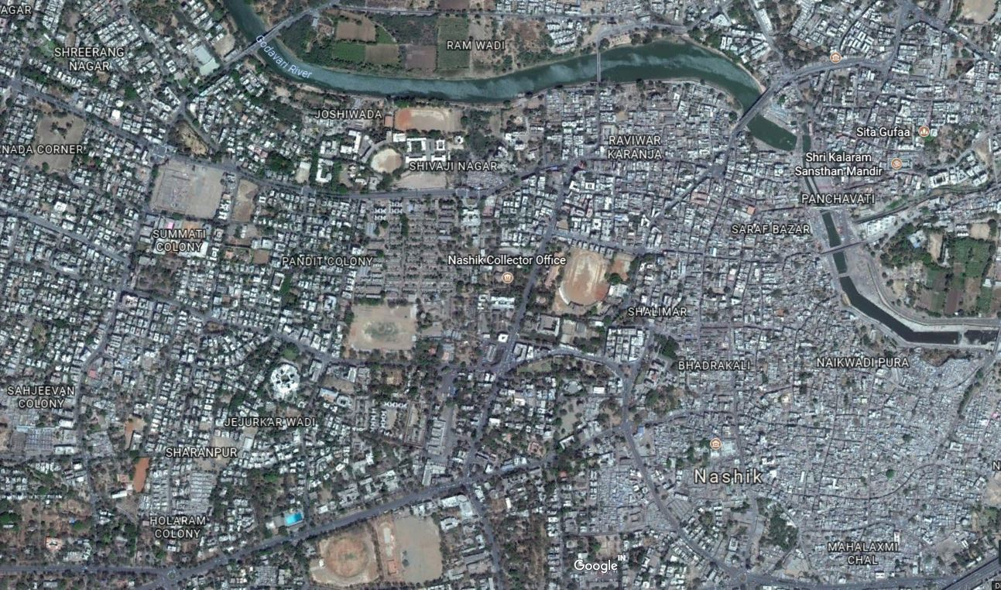
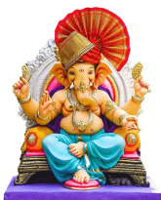
1½ ukf’kd ‘kgj foltZu fejo.kqdhpk ekxZ%&
pkSd eaMbZ ¼okdMh ckjo½ rs Eglksck egkjkt iVkax.k xksnkojh unh

Slide 11
eq[; foltZu fejo.kqd dz- 2
2½ Ukkf’kdjksM] miuxj iks-LVs- gn~nhr %&
ukf’kdjksM iks-LVs- gn~nhrhy x.ks’k foltZu fejo.kqd gh fcVdks pkSd ;sFkwu lq: gksr vlwu rh N=irh f’kokth egkjkt iqrGk& nsoh pkSd& ukf’kdjksM jsYosLVs’ku pkSd& lRdkj ikWbaV& ¼miuxj gn~n½ Jhjke eafnj& nsoGkyh xko &okynsoh unh ;sFkhy foltZu LFkGkoj lairs-
lnj ekxkZiklwu tkek eLthn 50 QqV varjkoj vkgs- lnj fBdk.kh feJ oLrh vkgs-

Slide 12
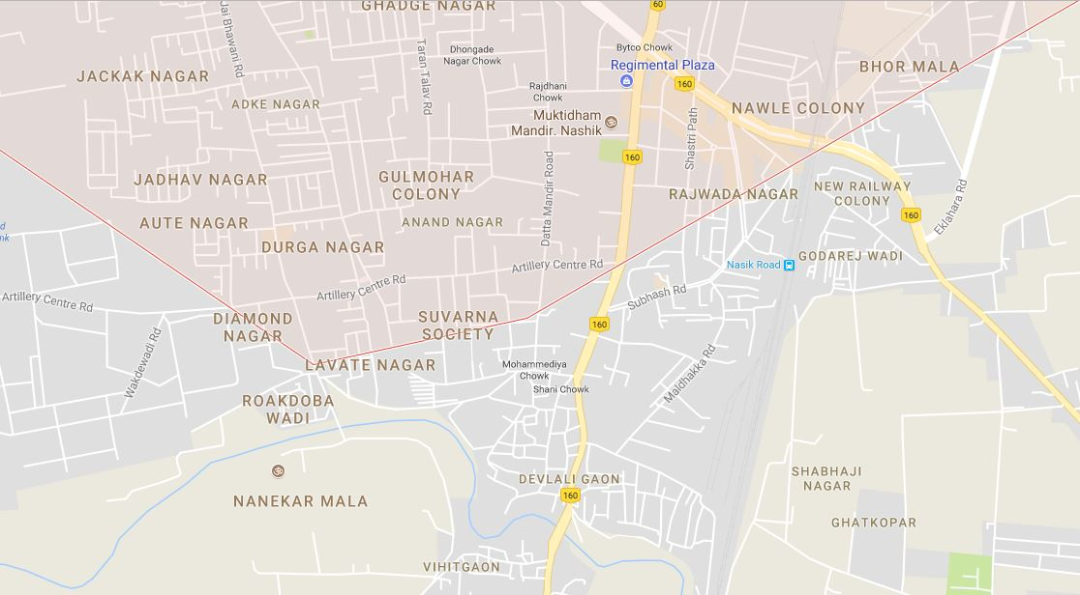
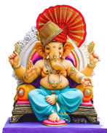
2½ ukf’kdjksM foltZu fejo.kqdhpk ekxZ %&
fcVdks pkSd rs okynsoh unh

Slide 13
eq[; foltZu fejo.kqd dz- 3
3½ nsoGkyh dWEi iks-LVs- gn~nhr %&
nsoGkyh dWEi iks-LVs- g|hrhy x.ks’k foltZu fejo.kqd gh laljh ukdk ;sFkwu lq: gksr vlwu gh flysD’ku dkuZj & tqus clLVkWi& >saMk pkSd& gkWVsy ‘kkjnk& gkWVsy osyde& guqeku eafnj& tqus clLVkWi & iqUgk flysD’ku dkWuZj& laljh ukdk& laljh xko &nkj.kk unh ;sFkhy foltZu LFkGkoj lairs-
Hkxwj ;sFkhy x.ks’k foltZu fejo.kqd gh f’kokth pkSd ;sFkwu lq: gksr vlwu ekjokMh xYyh& cydoMs irlaLFkk& oatkj xYyh& flrGk nsoh eafnj& Hkxwj uxjikfydk& f’kokth pkSd& dzkarh pkSd& jktokMk & nkj.kk unhoj foltZu dj.;kr ;sr vlrs-
lnj ekxkZoj eqLyhe yksdoLrh vFkok feJ yksdoLrh ukgh- eLthngh fejo.kqd ekxkZiklwu 800 rs 1000 feVj varjkoj vkgs-
;k O;frfjDr brj fBdk.kh ns[khy ygku fejo.kqdk fu?krkr-
mnkj.kkFkZ % lkriqj] vacM] xaxkiqj] vkuanoyh] vkMxko] e[keykckn xko] Hkxqj ns-dWEi] f’kns] iGls-

Slide 14
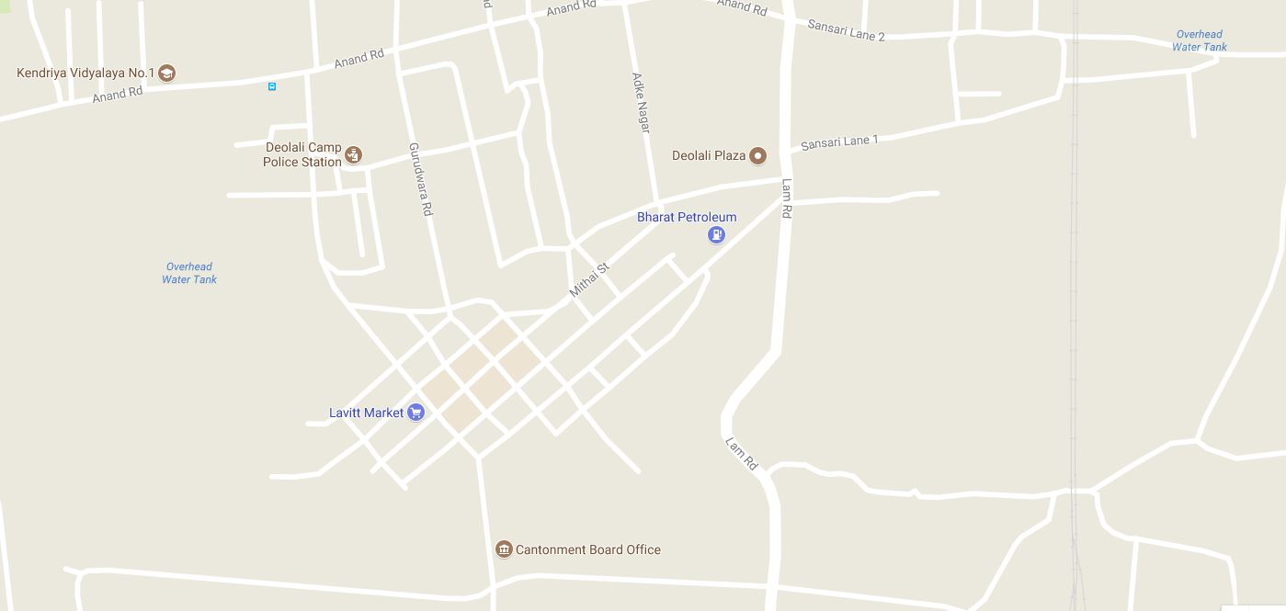
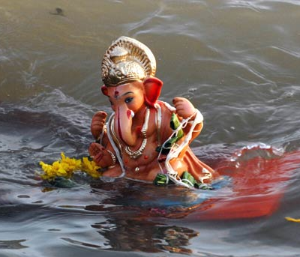
3½ ns-dWEi foltZu fejo.kqdhpk ekxZ%&
laljhukdk rs nkj.kk unh

Slide 15
bZn&,&feykn fufeRr dk<.;kr ;s.kkjs tqywl ekxZ
1½ Hknzdkyh iks-LVs-%& fejo.kqd ekxZ%& pkSdeaMbZ & f’kjlkB gkWVsy& ckxokuiqjk & dFkMk efLtn & f’kokthpkSd & fejk nkrkj nxkZ & f’kaih xYyh& vk>kkn pkSd & pOgkVk & pOgkVknsoh eafnj & Nijhph rkyhe & lqHkk”k okpuky;& cq/kokj isB& vkne’kgk nxkZ & lar ukenso iFk& dkthiqjk iksyhl pkSdh & dksd.khiqjk & mejko esMhdy & [kMdkGh & egkRek Qqys eaMbZ ekdsZV & lS¸;n yLlh pkSd & =acd iksyhl pkSdh & vCnqy gehn pkSd & nq/kcktkj & fiatkj?kkV & cMh nxkZ ;sFks foltZu lq: 15-00 rs 21-00 ikosrks o 15 rs 20 okgus] fj{kk] v’kk okgukalg rlsp tuleqnk; 8000 rs 10000 gtkj-
2½ ukf’kdjksM iks-LVs-%& vatqeu xkslkoh okMh & vatqeu ‘kkGk & MkW- ckcklkgsc vkacsMdj iqrGk & f’kokth iqrGk ¼pkSd½ & fcVdks pkSd & ,e th jksMus eqDrh/kke & lRdkj ikWbZV & fofgrxkao dkWuZj ijr fQ:u egkRek xka/kh iqrGk nsoGkyhxkao-lq: 11-30 rs 14-00 ikosrks tuleqnk; 5000 rs 6000 o 4 fp=jFk] 14 okgus] 20 pkjpkdh] 6 fj{kk lgHkkxh gksrkr-
ojhy 02 eq[; fejo.kqd@tqywl O;rhfjdr vkMxko ]bafnjkuxj] vacM] miuxj] nsoGkyh dWEi iksyhl LVs’ku gn~nhr NksV;k fejo.kqdk dk<.;kr ;srkr- ,dq.k fejo.kqd@tqywl 11 vkgsr-
bZn&,&feykn fufeRr loZ ef’kn e/;s lkeqfgd uekt iB.k brj /kkfeZd dk;Zdze gksrkr-

Slide 16
lkoZtfud x.kirh eaMGs o rsFkhy lks;h o lqfo/kk
Ukkf’kd iksyhl vk;qDrky; gn~nhr ,dw.k 790 lkoZtfud x.ks’k aeaMGs vlwu
lkoZtfud x.ks’k eaMGkps fBdk.kh Lo;alsod use.ksckcr eaMGkauk dGfo.;kr vkysys vkgs-
rlsp lkoZtfud eaMGkP;k fBdk.kh lh-lh-VhOgh dWesjs yko.;kckcr lqpuk ns.;kr vkys vkgs-
lkoZtfud eaMGkauh n’kZuk dfjrk ;s.kk&;k L=h o iq:”kkaP;k osxosxG;k jkaxk yko.ksckcr lqpuk ns.;kr vkY;k vkgsr-
egRokP;k lkoZtfud eaMGkaps fBdk.kh fQDl ikWabZV cankscLr yko.;kr ;srks-
ekSY;oku x.kirhP;k fBdk.kh fo’ks”k lqj{kk iqjoyh tkrs-
lkoZtfud x.ks’k eaMGkps fBdk.kh cWfjdsfVax o Lora= ikdhZZax Bso.ksckcr eaMGkauk dGfo.;kr vkys vkgs-
lkoZtfud x.ks’k eaMGkauh fnolk o jk=h Lo;alsod usekos ckcr dGfo.;kr vkys vkgs- rlsp lkoZtfud eaMGkaP;k fBdk.kh fi.;kps ik.kh o izlk/ku x`gkph lks; dj.ks ckcr dGfo.;kr vkys vkgs-

Slide 17
foltZu ?kkV
v-u- | iksyhl LVs’ku | foltZu ?kkVkps ukao
1- | iapoVh | Eglksck iVkax.k iapoVh] jkeokMh iqy ukf’kd
2- | vkMxko | riksou] ukanqj xko] ekuqj] f’kykiqj] yk[kyxko] vks<k] ekaMlkaxoh
3- | xaxkiqj | xaxkiqj xkao] lkses’oj /kc/kck]vkaunoyh] vklkjke ckiq iqy
4- | ljdkjokMk | ?kkjiqjs ?kkV] ds-Vh-,p-,e dkWyst] pksiMk ykWUl
5- | vacM | vk;-Vh-vk;-iqy
6- | ukf'kdjksM | nld xkao iqypsgMh xkao] nkj.kk unh
7- | miuxj | nsoGkyh xkao] okynsoh unh fiaiGxko [kkac
8- | nsoGkyh dWEi | laljh xkao nkj.kk unh Hkxqj] nkj.kk unh
foltZu ikWabZV rlsp rsFkhy jk=hP;k osGh dj.;kr ;s.kk&;k lks;h lqfo/kk
ukf’kd iksyhl vk;qDrky; gn~nhr ,dw.k 07 foltZu fBdk.ks vlwu foltZukps fno’kh egkuxj ikfydk o dWUVksesaV cksMZ ekQZr iz[kj fotsph tujsVjlg O;oLFkk dj.;kr ;srs-
rlsp foltZukps fBdk.kh thoj{kdkaph use.kqd euik ekQZr dsyh tkrs-
folZtukps fBdk.kh iqjsls euq”;cG cankscLrkdkeh use.;kr ;srs-
rlsp foltZukps fBdk.kh euik rQsZ x.ks’k eqrhZ ladfyr dj.;kph O;oLFkk dsyh tkrs-

Slide 18
6- cankscLr njE;ku ;s.kkÚ;k leL;k o mik; ;kstuk
cankscLrk njE;ku jLR;koj ykbZVph iqjs’kh O;oLFkk ul.ks-
fejo.kqdk foukdkj.k jsaxkG.ks-
fejo.kqdkaph mf’kjk lqjokr dj.ks-
fejo.kqdh njE;ku ckFk:eph O;oLFkk ul.ks-
fejo.kqd ekxkZoj ykdMh cWjsdsVhax ul.ks-
eaMGkps <ksy iFkd x.ks’k eaMGki;Zr mf’kjk iksgksprkr-
jLR;kaojhy [kM~M;kaeqGs fejo.kqdhl foyac gksrk-
fejo.kqd ekxkZOkj deh maphP;k dekuh] yksacdG.kkÚ;k fotsP;k rkjk ;keqGs x.ks’k eqrhZ vM.;kph laHkkouk vlrs-
ojhy loZ leL;kackcr iksyhl iz’kklukus ?ksrysY;k leUo; cSBfdr lacf/kr foHkkxkP;k vf/kdkÚ;kauk lfoLrj lqpuk ns.;kr vkY;k vkgsr- rlsp R;kauk ys[kh dGfo.;kr vkys vkgs-

Slide 19
7- okgus
x.ks’kksRlo cankscLrkdfjrk eksVkj ifjogu foHkkx ukf’kd ‘kgj ;kaps dMqu vko’;drsuqlkj okgus iqjfo.;kr ;srkr-
rlsp vf/kd okgukaph vko’;drk HkklY;kl brj ‘kkldh; foHkkx ;kapsdMqu okgus vf/kxzghr dsys tkrkr

Slide 20
8- miyC/k euq”;cG
izdkj | iksyhl vk;qDr | iksyhl mik;qDr | l-iks-vk- | iksyhl fufj{kd | l-iks-fu- | iks-m-fu- | iksyhl vaeynkj
eatqj la[;kcG | 1 | 4 | 8 | 56 | 67 | 125 | 3071
gtj la[;kcG | 1 | 4 | 7 | 45 | 52 | 99 | 2865
fjDr | & | & | 01 | 11 | 15 | 26 | 206
x.ks’kksRlo o bZn&,&feykn dfjrk vfrfjDr euq”;cGkph ekfgrh ckcr--
v-ua- | izdkj | ,l-vkj-ih-,Q- | Izkf’k{k.kkFkhZ iksyhl mi fujh{kd | jsYos iksyhl | gksexkMZ
 |  |  | iq:”k | iq:”k | iq:”k | efgyk
1 | ekx.kh dj.;kr vkysys euq”; cG | 01 daiuh | 58 | 25 | 1100 | 250
Ukf‘kd iksyhl vk;qDrky; dz- d{k 10 fo’kk @ fganq Vscy @ x.ks’kksRlo cankscLr&@ 5313@2024@fn-28@08@2024 vUo;s ek- iksyhl egklapkyd dk-o-lq- dk;kZy; eqacbZ ;kauh iqjfoyk vkgs-

Slide 21
9- cankscLrk njE;ku nG.k&oG.k
x.ks’kksRlo 2024 o bZn&,&feykn ps vuq”kaxkus ukf’kd iksyhl vk;qDrky; dk;Z{ks=kr ok;jysl dE;qfuds’ku lqfLFkrhr vkgs-
‘kgj okgrqd ‘kk[kk dfjrk Lora= pWuy ua 05 dk;ZfUor vkgs-
eq[; laidkZdfjrk Lora= pWuy ua 03 dk;ZfUor vkgs-
x.ks’kksRlo o bZn&,&feykn njE;ku cankscLr dkeh vko’;drsuqlkj okWdhVkWdh o LVWfVd lsV ph ekx.kh dj.;kr ;s.kkj vkgs-
x.ks’kksRlo o bZn&,&feykn 2024 P;k vuq”kaxkus cankscLrk lkBh lans’kogukdfjrk iksyhl vf/kdkjh ;kauk tkLrhr tkLr okWdhVkWdh ns.;kr ;s.kkj vkgs-
eq[; fejo.kqd ekxkZoj ukxfjdkauk lqpuk ns.ks tutkx`rh dj.ks dfjrk ih, flfLVeps fu;kstu dj.;kr vkysys vkgs-
fejo.kqd folZtukps fBdk.kh ok;jysl lsV yko.;kr ;s.kkj vkgs-
eq[; fejo.kqd ekxkZoj vko’;drsuqlkj okWp VkWoj yko.;kr ;s.kkj vlwu VkWoj oj l’kL= iksyhl vaeynkj nqchZ.k lg fu;qDr dj.;kr ;s.kkj vkgs-

Slide 22
10- ,l- vkj- ih- ,Q- daiuh
x.ks’kksRlo o bZn&,&feykn 2024 ps vuq”kaxkus ukf’kd ‘kgj vk;qDrky; gn~nhr 02 ,l-vkj-ih-,Q- daiuhph vko’;drk vlrs-
Hknzdkyh iksyhl LVs’ku gn~nhr nq/kctkj pkSd] ljdkjokMk iks-LVs gn~nhr jfookj dkjatk] ukf’kdjksM iks-LVs gn~nhr Jh N=irh f’kokth egkjkt ;kapk iqrGk rlsp xksnkojh unh ik= nld ?kkV ;k fBdk.kh ,l-vkj-ih-,Q IykVqu Bso.;kr ;srs-
vk;qDrky;krhy lfeJ oLrh]laonsu’khy fBdk.ks rlsp vko’;drsuqlkj ,l-vkj-ih-,Q- daiuhps fu;kstu dj.;kr ;srs-

Slide 23
11 - /kkfeZd rs< vFkok lkekftd r.kko vlysyh fBdk.ks
Hknzdkyh iksyhl LVs’ku gn~nhrhy 1½pkSd eaMbZ] 2½f’kokth pkSd]3½vk>kn pkSd]4½ fiaiGpkSd & lnj fBdk.kh ‘kkarrk vckf/kr jgkoh ;k dfjrk ‘kkarrk lferh lnL;] eksgYyk dfeVh] ;kaP;k cSBdkaps fu;kstu dj.;kr vkys vkgs- rlsp lnj fBdk.kh pkSdlHkk ?ks.;kr vkY;k vkgs-

Slide 24
12- Lkaosnu’khy fBdk.ks
v-dz- | iks-LVs- | fBdk.kkaps oxhZdj.k | laosnuf’ky fBdk.ks
1 | Hknzdkyh | lfeJ yksdoLrh | nq/kcktkj] dFkMk]tqus ukf’kd] ‘kkyhekj] xk-e- iqrGk] froa/kk] cMh nxkZ] ch-Mh- Hkkysdj eSnku] Onkjdk] oMkGkukdk
2 | ljdkjokMk | xnhZps fBdk.k | jfookj dkjatk] v’kksdLRkaHk] esgsj flXuy] fl-ch-,l- flXuy
3 | iapoVh | xnhZps fBdk.k | ekysxko LVW.M] isB jksM] iapoVh dkjatk] ljnkj pkSd
4 | eqacbZukdk | lfeJ yksdoLrh | Hkkjr uxj] Onkjdk
5 | xaxkiwj | xnhZps fBdk.k | uo’;k x.kirh] vkuanoyh nxkZ
6 | ukf’kdjksM | xnhZps fBdk.k | fcVdks pkSd] tsyjksM] flUuj QkVk
7 | miuxj | xnhZps fBdk.k | nsoGkyh xko] nRr eafnj
8 | ns- dWEi | xnhZps fBdk.k | Hkxwj
9 | vacM | xnhZps fBdk.k | iouuxj] mRreuxj] f=eqrhZ pkSd] LVsV cWd pkSd] vacM fyad jksM
10 | lkriwj | xnhZps fBdk.k | Vkmu pkSdh] efgaanzk vW.M efgaanzk >ksiMiV~Vh] Lokjckckuxj] v’kksduxj

Slide 25
Lakosnu’khy fBdk.kh dj.;kr ;s.kkjh dk;Zokgh
lnj ifjljkr iksyhl LVs’ku Lrjkoj :V ekpZ dj.;kr ;srks-
‘kkarrk lferh] eksgYyk dfeVh] iksfyl fe= la?kVuk ;kaP;k cSBdk ?ks.;kr vkY;k vkgsr-
lnj Hkkxkr lh-lh-fVOgh dWesjs yko.ks ckcr lqpuk ns.;kr vkys vkgs-
lnj Hkkxkr vko’;drsuqlkj cankscLr yko.;kr ;srks-
dksfcax vkWijs’ku jkcfo.;kr ;s.kkj vkgs-
Mªksu dWesjkpk okij dj.;kr ;s.kkj vkgs-
,l-vkj-ih-,Q- IykVqu yko.;kr ;s.kkj vkgs-
jsdkWMZ ojhy xqUgsxkj ;kauk LFkkuc/n dj.;kr ;s.kkj vkgs-

Slide 26
13 - x.kirh o bZn&,&feykn njE;ku nk[ky xqUgs
lu | Hkkx 1 rs 5 |  | Hkkx &6 |  | ,u-lh-
 | nk[ky | l|fLFkrh | nk[ky | l|fLFkrh | nk[ky
2018 | 02 | U;k;izfo”B | 02 | U;k;izfo”B | 01
2019 | fujad | fujad | fujad | fujad | fujad
2020 | fujad | fujad | fujad | fujad | fujad
2021 | 01 | U;k;izfo”B | fujad | fujad | 02
2019 e/;s xaxkiqj iks-LVs- gn~nhr x.ks’k foltZukP;k osGh xksnkojh unh ik=kr cqMqu 01 ble e;r >kyk vkgs-
2020 e/;s ukf’kdjksM o miuxj iks-LVs- gn~nhr x.ks’k foltZukP;k osGh nkj.kk o okynsoh unh ik=kr cqMqu 02 ble e;r >kys vkgsr-
2021 e/;s iapoVh iks-LVs- xq-j-ua- 308@2021 Hkknfo dye 304 ¼v½]279]337]380 eksVkj okgu vf/kfu;e 1988 ps dye 184 izek.ks 01 xqUgk nk[ky vlqu U;k;izfo”B vkgs-
2022 e/;s iapoVh iks-LVs- xq-j-ua- 356@2022 Hkknfo dye 326] 324]323]504]34 izek.ks xqUgk nk[ky vlqu U;k;izfo”B vkgs-

Slide 27
x.ks’kksRlo 2021 e/;s ukf’kd iksyhl vk;qDrky;kr
iapoVh iks-LVs ;sFks 01 xqUgk nk[ky vkgs-
1 | iksyhl Bk.ks | % | iapoVh iksyhl LVs’ku] ukf’kd ‘kgj
2 | xq-j-u dye | % | xqjua- 308@2021 Hkknfo dye 304¼v½]279] 337]338 eksVkj okgu vf/kfu;e 1988 ps dye 184 izekk.ks
3 | fQ;kZnhps uko | % | iksf‘k@ 664 fnyhi fuo`Rrh ok:axls use iapoVh iks-LVs- ukf’kd ‘kgj
4 | vkjksih | % | xksj[kukFk y{e.k >ksackM o; 28 o”kZ jk- ukf’kd
5 | xq-?k-rk-osG o fBdk.k | % | fn-19@09@2021 jksth 08-50 oktsps lqekjkl Eglksck iVkax.k iapoVh ukf’kd
6 | xqUgk nk-rk- o osG | % | fn-19@09@2021 jksth 13-03 ok-
7 | gdhxr | % | ojhy rkj[ksl osGh o fBdk.kh ;krhy vkjksihr ;kus R;kps rkC;krhy Maij gyxthZus pkyoqu rsFks clysY;k blekl tksjkph Bksl ekjyh R;kr jLR;kP;k cktql clysyk 60 o”kkZpk ble e;r >kyk gksrk- lnj vi?kkr gk x.ks’k foltZukps fBdk.kh >kyk gksrk--

Slide 28
x.ks’kksRlo 2022 e/;s ukf’kd iksyhl vk;qDrky;kr
iapoVh iks-LVs ;sFks 01 xqUgk nk[ky vkgs-
1 | iksyhl Bk.ks | % | iapoVh iksyhl LVs’ku] ukf’kd ‘kgj
2 | xq-j-u dye | % | xqjua- 356@2022 Hkknfo dye 326]324]323]504]34 izek.ks
3 | fQ;kZnhps uko | % | _”khds’k v’kksd xjM o; 25 O;olk; etqjh] jk- xtkuu pkSd] xq:Onkjk jksM ?kj ua 4216 iapoVh ukf’kd
4 | vkjksih | % | 1½Ek;qj mQZ MkUlj HkkLdj iokj jk- dksGhokMk x.ks’kokMh iapoVh ukf’kd 2½ vkdk’k panzHkku xk;dokM jk- dksGhokMk x.ks’kokMh iapoVh ukf’kd
5 | xq-?k-rk-osG o fBdk.k | % | fn-09@09@2022 jksth 20-45 oktsps lqekjkl x.ks’kokMh nsoheafnjkleksj iapoVh ukf’kd
6 | xqUgk nk-rk- o osG | % | fn-10@09@2022 jksth 00-14 ok-
7 | gdhxr | % | ojhy rkj[ksl osGh o fBdk.kh ;krhy fQ;kZnh gk lIrJ`axh eaMGkpk dk;ZdrkZ vlwu rks lIrJ`axh x.ks’k eaMGkps x.kirh folZtukps fejo.kqdhr vlrkauk R;kus fejo.kqdhph xkMh iq<s ?ksryh R;k xks”Vhpk vkjksihr ;kauk jkx ;sowu rq xkMh iq<s dk ?ksryh vkEgkl ukpk;ps gksrs vls Eg.kqu dwjkir dk<wu fQ;kZnhl okbZV lkbZZV f’kohxkG d:u /kDdk cwDdh d:u vkjksih ua 1 ;kus R;kps f[k’kkrhy pkdq dk<wu fQ;kZnhP;k MkO;k cktwl dacjstoG okj d:u vi[kq’khus nq[kkir dsyh Eg.kwu xqUgk-

Slide 29
15- vuar prqn’khZ o bZn&,&feykn vuq”kaxkus r;kjh
x.ks’k eaMGs o ‘kgjs [krhc ;kaph cSBd ?ks.;kr vkyh vlwu bZn&,&feykn tqyql fejo.kqd
gh fn- 16@09@2024 fdaok fn- 17@09@2024 jksth ¼panzn’kZukuqlkj ½ dk<.;kr ;s.kkj vkgs-
lnj tqywl fejo.kqdhckcr eqfLye /keZxq: o x.ks’k eaMG ;kaph fn- 16@09@2024 P;k panzn’kZukuqlkj la;qDr cSBd ?ks.;kr ;s.kkj vkgs-
16 o 17- lks’ky feMh;k ekWfuVjhax
ukf’kd iksyhl vk;qDrky;kr fo’ks”k ‘kk[kk varxZr 01 vf/kdkjh o 13 vaeynkj rlsp iksyhl LVs’ku dMqu xksifu; ekfgrh ladfyr dj.;kr ;srs-
jkeiz/kku lferhP;k f’kQkj’khuqlkj iksyhl vk;qDr ;kaps v/;{krs[kkyh ukf’kd ftYg;krhy loZ foHkkxkP;k xqIrokrkZ ;a=.kkph cSBd ?ks.;kr ;sowu ekfgrhph nsok.k ?ksok.k dsyh tkrs-
x.ks’kksRlo o bZn &,&feykn ps vuq”kaxkus ‘kkarrk lferh lnL;] x.ks’keaMG v/;{k] x.ks’k eaMG inkf/kdkjh] izfr”Bhr ukxfjd ]MkWDVj]jfgok’kh lkslk;Vhps psvjeu] ;kaps OgkWVl vi xqzi r;kj dj.;kr ;sowu R;kr dks.krkgh v{ksikgZ lans’k]etdqj lks’ky feMh;koj izlkjhr gks.kkj ukgh- rlsp v{ksikgZ cWuj o gksMhZXTk yko.;kr ;s.kkj ukghr- o dks.krkgh vuqfpr izdkj ?kM.kkj ukgh ;kph n{krk ?ks.;kr ;srs-
x.kirh o bZn&,&feykn fufeRr Lora= lks’ky feMh;k d{k LFkkiu dj.;kr vkysyk vlwu Jh dkSLrqHk lksyadh gs lnj d{kkps dkedkt ikgr vkgsr-
lks’ky feMh;k vWiOnkjs ekfgrh ?ksoqu fu;a=.k Bso.;kr ;sr vkgs-

Slide 30
18- iksyhl dY;k.k
cankscLrkdfjrk vlysys vf/kdkjh ] vaeynkj ] gksexkMZ] VªkfQd okWMZu] ;kauk fu;fer QqM iWdsV]
fi.;kps ik.kh] rlsp cankscLrkps fBdk.kh racq] jkgqVh] ohtsph O;oLFkk dj.;kr ;s.kkj vkgs-
x.ks’kksRlo o bZn&,&feykn 2024 cankscLrkdfjrk ckgs:u ;s.kkjs vf/kdkjh] vaeynkj] gksexkMZ];kaph jkg.;kph O;oLFkk iksyhl LVs’ku fugk; dj.;kr ;s.kkj vkgs-
cankscLrkps vf/kdkjh o vaeynkj ;kaps osGsr fjyhQ ph dk;Zokgh dj.;kr ;s.kkj vkgs-
iksyhl fujh{kd iksyhl dY;k.k gs ojhy lanHkkZus ns[kjs[k djrhy-
19- x.ks’kksRlo o bZn&,&feykn lktjs gks.;kph fBdk.ks
ukf’kd iksyhl vk;qDrky; gn~nhr x.ks’kksRlo eksB;k izek.kkr Hknzdkyh] ljdkjokMk] iapoVh] ukf’kdjksM iksyhl LVs’ku gn~nhr lktjk djrkr-
ukf’kd iksyhl vk;qDrky; gn~nhr bZn&,&feykn eksB;k izek.kkr Hknzdkyh] ukf’kdjksM iksyhl LVs’ku gn~nhr lktjk djrkr-
R;kvuq”kaxkus v o c ikWabZV] fQDl ikWabZV] ?kkrikr fojks/kh rikl.kh] xqMekWfuZx LdkWM] eksckbZy isVªksfyax] eaMGkaph O;fDrxr lqj{kk j{kd rlsp ekSY;oku eaMGkauk l’kL= iksyhl vaeynkj ;kaph use.kqd dsyh tkrs-

Slide 31
20- ‘kkarrslkBh djko;kP;k mik;;kstuk
x.kirh eaMGkaP;k inkf/kdkÚ;kaP;k feVhax ?ksoqu R;kauk vko’;d lqpuk@ekfgrh ns.ks-
xqUgsxkjh jsdkWMZ vlysY;k xaqMkaoj izfrca/kkRed dk;ZOkkgh dj.ks-
Qjkjh@ikghts vlysys xqaM@xqUgsxkj] rMhikj ;kapk ‘kks/k ?skoqu dk;Zokgh dj.ks
egkuxjikyhdsdMqu vko’;d mik; ;kstuk mnk- jLrk nq:Lrh] jks”k.kkbZ] ik.kcqMs iFkd use.ks] oxSjs dk;Zokgh d:u ?ks.ks-
brj [kkrs mnk- fot forj.k daiuh] VsyhQksu] vkjksX; foHkkx] vXuh’keu ny] gksexkMZ] Lo;alsoh la?kVuk bR;knhaph enr ?ks.ks-
ukf’kd iksyhl vk;qDrky;] gn~nhr fuHkZ;k iFkd] nkfeuh iFkd ;kaph isVªksfyax use.;kr vkyh vkgs-
xqUgs ‘kk[ks dMhy iFkdk ekQZr gn~nhr fid ikWdhV] pSu LuWfpax gks.kkj ukgh ;kdjhrk isVªksfyax use.;kr ;s.kkj vkgs-
x.ks’k fejo.kqdk jaasxkG.kkj ukgh] nksu eaMGkae/;s varj iM.kkj ukgh ;kckcr n{krk ?ks.;kdjhrk eaMGkauk lqpuk ns.;kr vkY;k vkgsr-
fejo.kqd ekxkZoj egRokP;k fBdk.kh ykdMh cWjhdsVhax dj.ks ckcr euik ;kauk dGfo.;kr vkys vkgs-
x.ks’k foltZu fBdk.kh iqjs’kk fotsph O;oLFkk o ftoj{kd use.ksckcr euik dMs i= O;ogkj dj.;kr vkys vkgs-
ukf’kd iksyhl vk;qDrky;] gn~nhr voS/k /kans pky.kkj ukgh ;kph n{krk ?;koh-

Slide 32
iksyhl vf/kdkjh o vaeynkj ;kaP;k jtk o lkIrkfgd lqVV;k vko’;rk vlY;kl can d:u tkLrhr tkLr euq”;cG miyC/k d:u ?ks.ks-
egROkkps o laosnu’khy Hkkxkr fQDl ikWbZaV o isVªksyhax use.ks
egRokph /kkfeZd LFkGs] iqrGs bR;knh fBdk.kh cankscLr use.ks
jk[kho QkslZ dMqu vko’;drsuqlkj laosnu’khy Hkkxkr lapyu dj.ks
ek- iksyhl egklapkyd] e-jk-eaqcbZ] ek- vk;qDRk] jkT; xqIrokrkZ foHkkx ;kaP;k dMqu vkysyh ekfgrh loZ iks-LVs-yk dGfo.ks o R;kaP;k lqpukaps ikyu dj.ks- foltZu ekxkZoj Lokxr d{k mHkkj.kkÚ;k la?kVuk@jktdh; i{k ;kaph cSBd ?ksowu ,dp Lokxr d{k mHkkj.;kr ;kok ;klkBh lqpuk ns.ks-
x.ks’keqrhZps j{k.kklkBh izR;sd lkoZtfud x.ks’k eaMGs gs 24 rkl Lo;alsod userhy ;kckcr
loZ x.ks’k eaMGkauk lqpuk ns.ks
dks.krsgh lkoZtfud eaMGs tcjnLrhus oxZ.kh xksGk dj.kkj ukgh ;kckcr loZ x.ks’k
eaMGkauklqpuk ns.ks-
lkoZtfud x.ks’k eaMGkps x.kirh eaMikeqGs dks.kR;kgh izdkjs jgnkjhl vMFkGk fuekZ.k gks.kkj ukgh ;kckcr loZ x.ks’k eaMGkuk lqpuk ns.ks-
lkoZtfud x.ks’k eaMGs eaMike/;s fdaok x.ks’k eqrhZ Hkksorh ykbZVhax djrkr fdaok vkjkl djrkr
rs vuqHkoh bysDVªh;’ku dMqu d:u ?;koh ts.ks d:u dks.kR;kgh izdkjps ‘kkWVZ ‘kfdZV gks.kkj ukgh ;kckcr loZ eaMGkauk lqpuk ns.ks
x.ks’k eqrhZaph LFkkiuk djrkauk] Hkkfodkauk x.ks’k eqrhZl Li’kZ djrk ;s.kkj ukgh ;kph n{krk ?ks.ks ckcr eaMGkauk lqpuk n;koh-

Slide 33
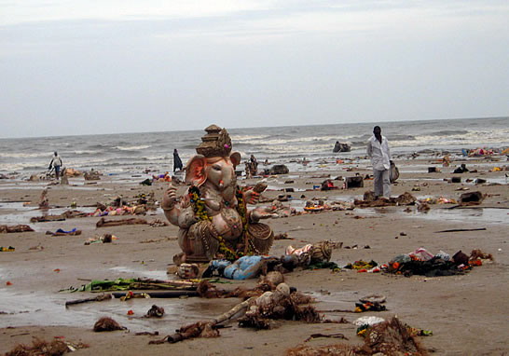
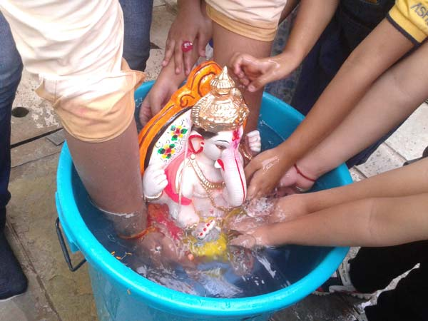


foltZu & eqrhZnku ¼ ik.kh iznq”k.k eqDr½

Slide 34
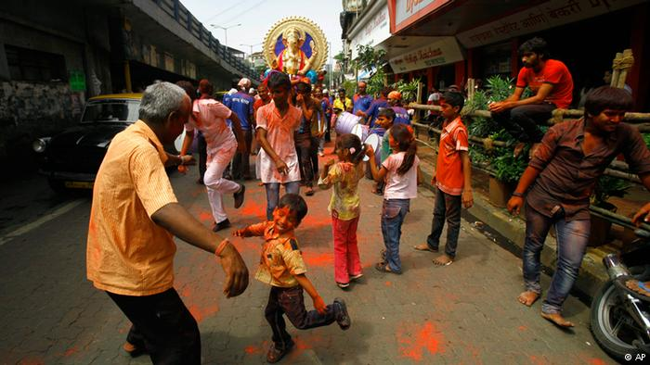
,d okWMZ ,d x.kirh

Slide 35
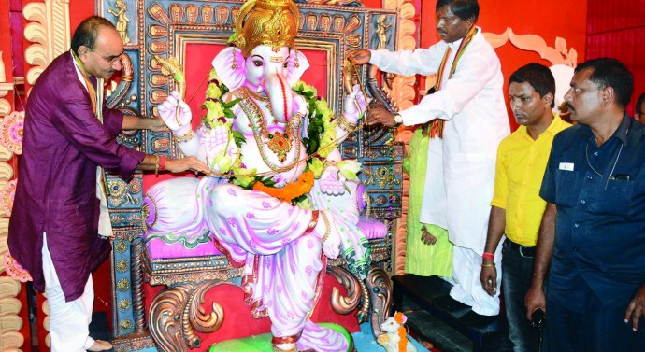
x.ks’k eaMG Lo;alsod use.kwd

Slide 36
laiow /ouh iznq”k.k ---
tiw;k i;kZoj.k - - -
ykMD;k x.kjk;kpk - - -
ok<ow;k eaxy l.k - - -
lkekftd ,sD;krwup izxrh

Slide 37

/kU;okn---

